Slide 1
DBSCAN ALGORITHM
CLUSTERING ALORITHMS

Slide 2
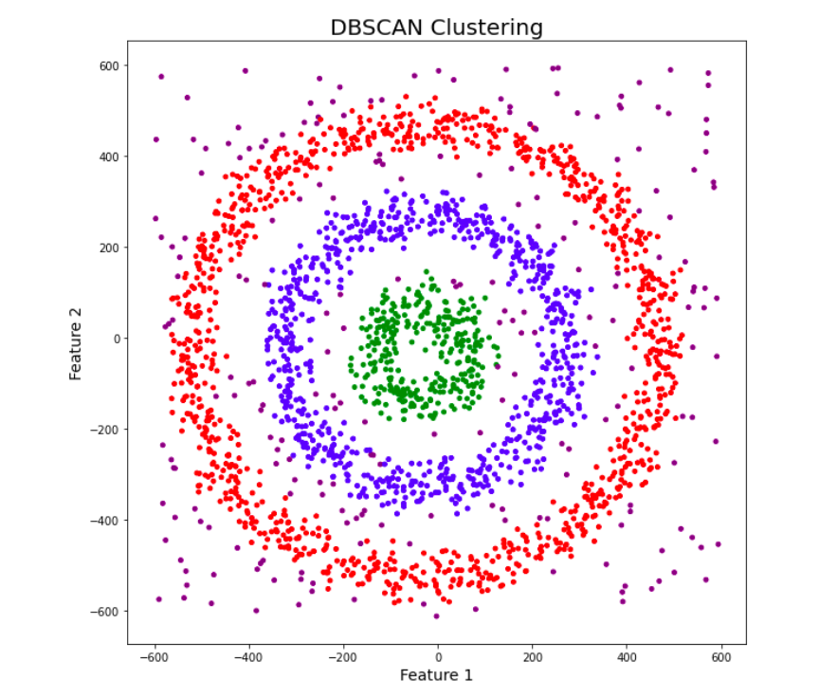
What is DBSCAN?
Definition: A clustering algorithm that identifies clusters based on the density of points.
Key Features:
Finds clusters of varying shapes.
Identifies noise as outliers.
Key Parameters of DBSCAN
Epsilon (ε):
Defines the radius to consider for neighborhood points.
MinPts:
Minimum number of points required to form a dense region.

Slide 3
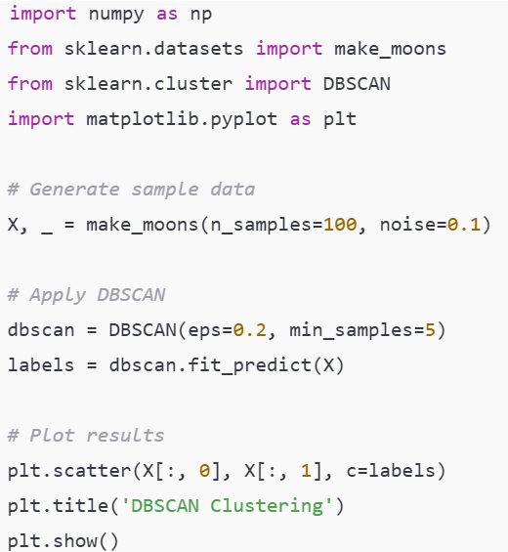
DBSCAN in scikit-learn
Examples:

